Slide 1
Friday 18th May 2018

Slide 2
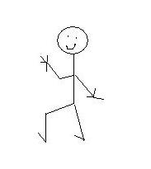
In your jotter draw this scale
Often
Never
Sometimes
Notes:
Ask pupils to use the scale to show how often they have felt the following ways in a Maths lesson….

Slide 3
In your Maths lessons, how often do you hear yourself thinking
I can’t do this…
Notes:
Before showing students the next slide ask if they can suggest an alternative way of thinking.

Slide 5
In your Maths lessons, how often do you hear yourself thinking
I can’t do this…
Notes:
Before showing students the next slide ask if they can suggest an alternative way of thinking.

Slide 6
Tell yourself
I can’t do this yet…

Slide 7
In your Maths lessons, how often do you hear yourself thinking
I’m no good at this…

Slide 8
Tell yourself
I can become better at this…

Slide 9
In your Maths lessons, how often do you hear yourself thinking
What level did I get?

Slide 10
Ask instead
What can I do to improve…

Slide 11
There is no such thing as a Maths person. Everyone can become a better learner in Maths
What strategies could you use when you get stuck?

Slide 12
Class Strategies for getting ourselves unstuck….
Notes:
Record the classes strategies on the board.

Slide 13
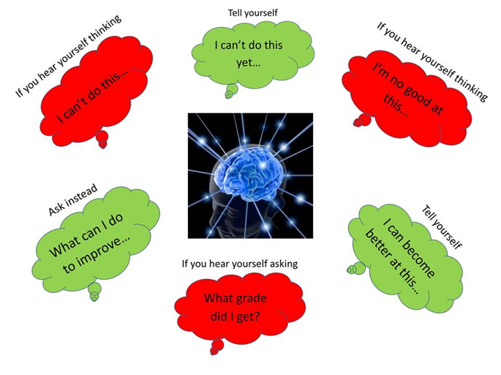

Slide 14
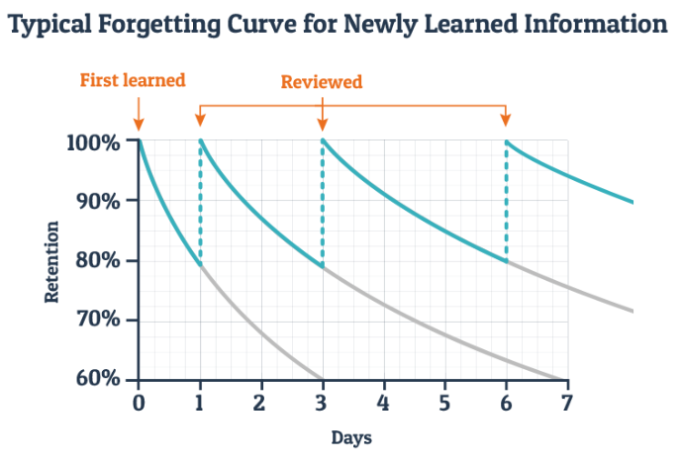

Slide 15
Growth Mindset Message
Maths is better with teamwork, Maths is not the enemy
https://www.youcubed.org/
Fixed Vs Growth
https://www.youtube.com/watch?v=KUWn_TJTrnU
4 Steps to developing a Growth Mindset
https://www.youtube.com/watch?v=aNHas97iE78
The Power of Belief
https://www.youtube.com/watch?v=pN34FNbOKXc

Slide 16
Get the App for Spaced Learning Anki is Japanese for Memorisation
Learning a language
Studying for medical and law exams
Memorising people's names and faces
Brushing up on geography
Mastering long poems
Even practicing guitar chords!

Slide 17
How your parents can help you
http://lhsmaths.weebly.com/

Slide 21
“The passion for stretching yourself and sticking to it , even (or especially) when it’s not going well is the hallmark of the growth mindset. This is the mindset that allows people to thrive during some of the most challenging times in their lives.”
Carole S Dweck

Slide 22
‘There is a difference between not knowing and not knowing yet.’
Sheila Tobias

Slide 23
A teacher’s job is not to make work easy. It is to make it difficult. If you are not challenged, you do not make mistakes. If you do not make mistakes, feedback is useless.
John Hattie

Slide 24
Sometimes what we call
“failure”
is really just that necessary struggle called learning.

Slide 25
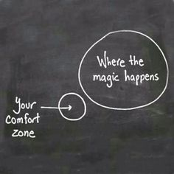

Slide 26
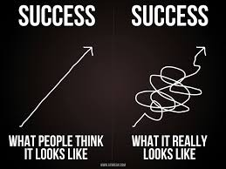

Slide 27
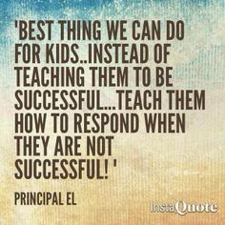

Slide 28
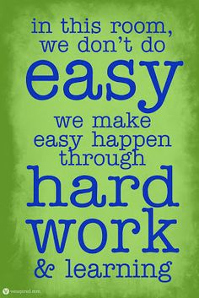
Notes:
Discuss the importance of changing the culture of learning with reference to PACA

Slide 29
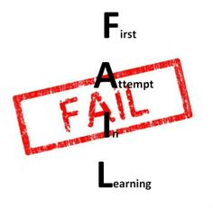

Slide 30
In this class….
We can all be successful
We can all learn from one another
We will all choose tasks that challenge us
We all have different starting points
We can all make progress
The best students are the students who make the most progress

Slide 31
